Slide 1
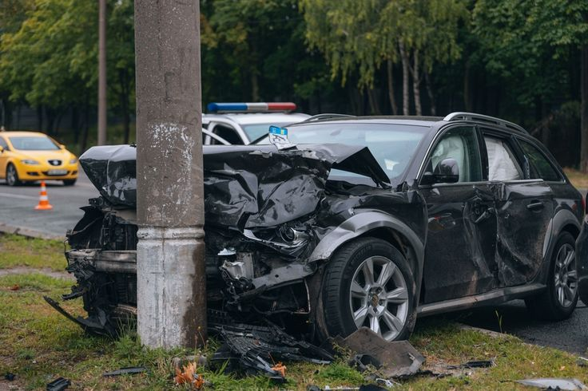
ACCIDENT DETECTION
Presented by:-
Suraj Nayak
Asmit Panigrahi
Aryan Padhiary
Sai Satyam Pal

Slide 2
INTRODUCTION
Accident detector is an all-in-one smart system designed to enhance vehicle safety, user convenience, and real-time connectivity.
It offers real-time features like GPS-based navigation, accident detection with instant alerts, and vehicle booking options.
Users receive timely reminders for insurance and pollution certificate renewals, helping them stay compliant effortlessly.
An integrated panic button ensures emergency assistance is just a tap away, enhancing driver security.
Vehicle-to-vehicle message communication allows for real-time interaction, promoting smarter and safer roads.

Slide 3
OBJECTIVES
To enhance vehicle safety through real-time accident detection and instant alert mechanisms.
To simplify vehicle management with features like GPS tracking, booking, and renewal reminders.
To provide quick emergency assistance via an integrated panic button system.
To enable seamless communication between nearby vehicles for smarter and safer roads.
To ensure user convenience by integrating multiple services into a single, easy-to-use platform.

Slide 4
Project Summary:
This project focuses on the development of an intelligent accident detection system designed to enhance road safety by providing real-time alerts during vehicular accidents. Using sensor data such as accelerometer, GPS, and optionally video feeds, the system identifies sudden changes in motion or collisions that indicate an accident. Once detected, the system automatically sends an alert to emergency contacts or services with the location details, enabling faster response times. The solution is aimed at reducing fatalities and injuries by minimizing the delay in post-accident assistance. The project demonstrates the feasibility of implementing smart safety systems in modern transportation and lays the groundwork for future integration with smart vehicles and traffic management infrastructure.

Slide 5
FEATURES
Navigation
Accident Alert
Booking
Panic Button
V2V Communication
Insurance Alerts

Slide 6
CORE COMPONENTS AND PLATFORMS
Frontend: React
Backend: Node.js
Database: MongoDB
Hardware: ESP32, GPS, GSM, Vibration Sensor, Accelerometer, Voltage Regulator, Battery, Breadboard, Jumper Wires etc.

Slide 7
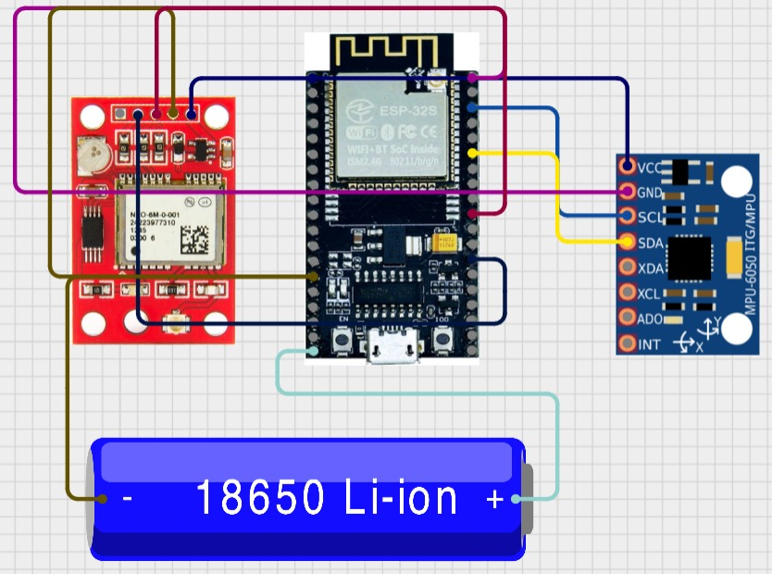
SYSTEM ARCHITECTURE
GPS
ESP32
MPU6050
BATTERY

Slide 8
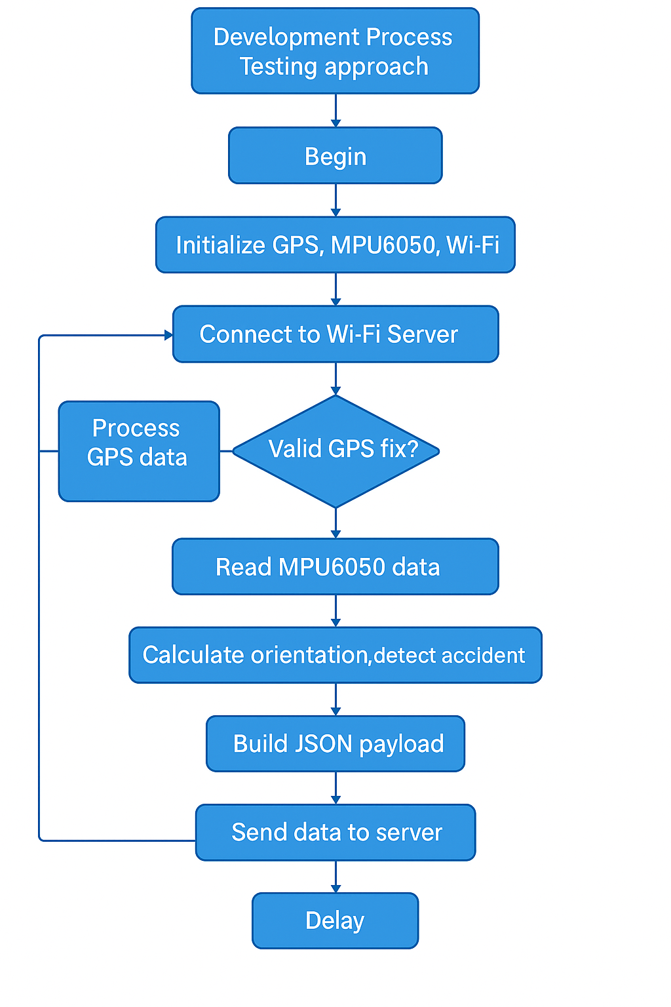
Development process
Testing approach

Slide 9
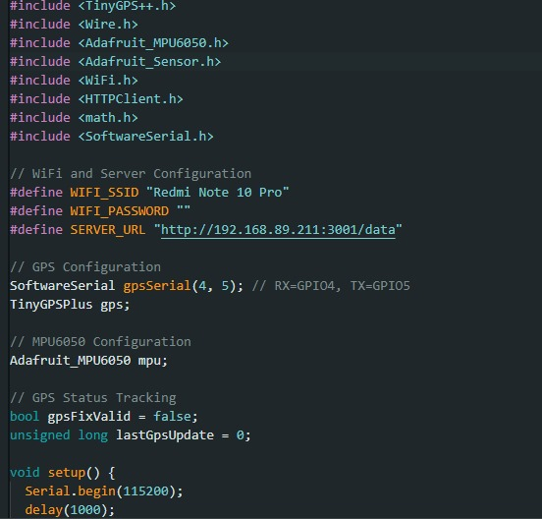
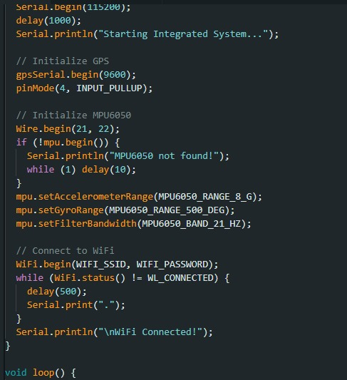
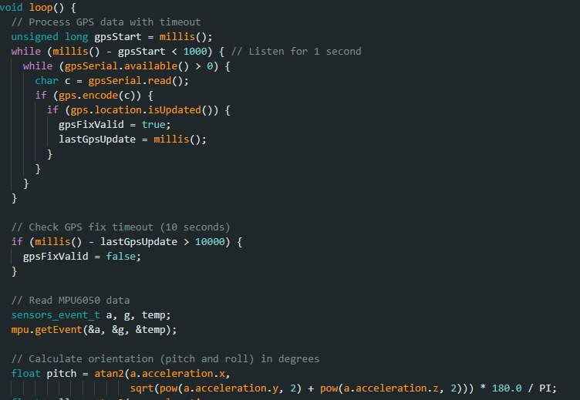
Code:

Slide 10
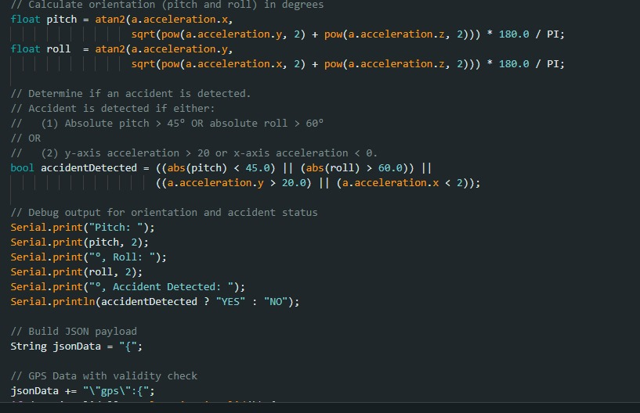

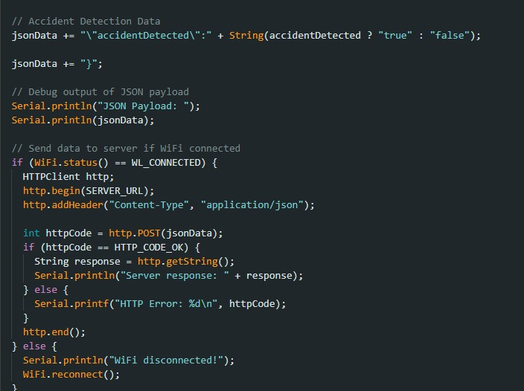
Code:

Slide 11
RESULT:
Iteration Latitude Longitude Accel X (m/s^2) Accel Y (m/s^2) \
0 1 0.000000 0.000000 -7.53 27.04
1 2 12.971158 77.594966 5.92 -20.64
2 3 12.972070 77.594932 6.07 12.48
3 4 0.000000 0.000000 -17.26 -19.09
4 5 12.971391 77.594712 -11.75 1.49

Slide 12
RESULT:
Accel Z (m/s^2) Pitch (°) Roll (°) Accident Detected
0 13.92 -13.90 59.67 True
1 -20.64 11.46 -43.87 False
2 -28.76 10.95 23.01 False
3 -19.00 -32.66 -36.64 True
4 -4.08 -69.70 6.81 True

Slide 13
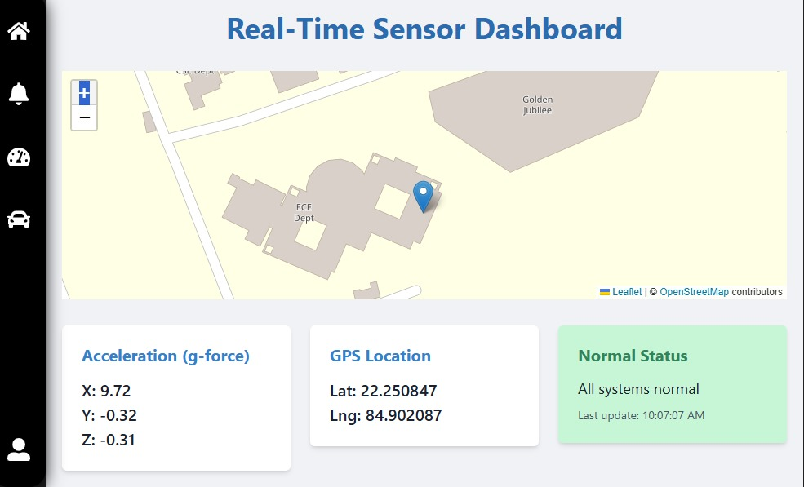
ACHIEVEMENT

Slide 14
LIMITATION
May produce false alarms or miss minor accidents.
Sensor/device failure can affect accuracy.
Weather and lighting conditions reduce effectiveness.
Raises privacy and data security concerns.
Requires stable network for real-time alerts.
High setup and maintenance cost.
Poor handling of uncommon or complex accident scenarios.

Slide 15
Future Improvements
Conduct extensive field testing across diverse scenarios to improve robustness.
Integrate AI/ML models to reduce false alerts and improve detection accuracy.
Add vehicle-to-vehicle (V2V) or vehicle-to-infrastructure (V2I) communication for enhanced
coordination.
Incorporate voice/video data for contextual analysis and emergency response optimization.

Slide 16
CONCLUSION
Accident detection systems play a vital role in enhancing road safety by providing real-time alerts and facilitating faster emergency responses. By utilizing sensors, computer vision, and machine learning algorithms, such systems can accurately identify collisions or abnormal vehicle behavior.
These systems not only help in minimizing fatalities by reducing response time but also assist in traffic management, data analysis, and preventive measures. Continued advancement in technologies like AI, GPS, IoT, and video surveillance will further improve the accuracy, efficiency, and reliability of accident detection systems, making roads safer for everyone.

Slide 17
THANK YOU
Refernces:-
https://www.rhydolabz.com/documents/GlobalTop-Ivory-3(Gmm-u2p)-Datasheet-V0D.pdf
https://www.espressif.com/sites/default/files/documentation/esp32_datasheet_en.pdf
Submitted by:- suraj kumar Nayak
Roll no 122ec0135

